Slide 1
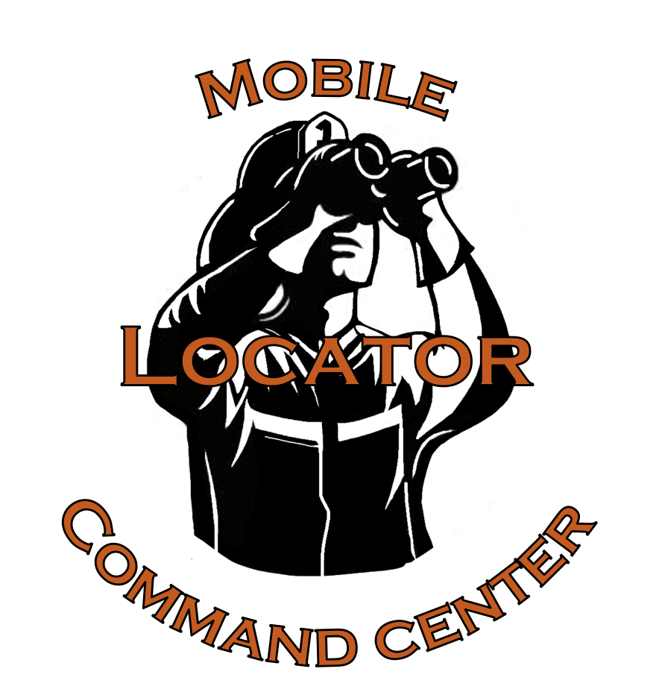
Group 2:
Anna Nordlöv
Qu Wang
Rob de Groot

Slide 2
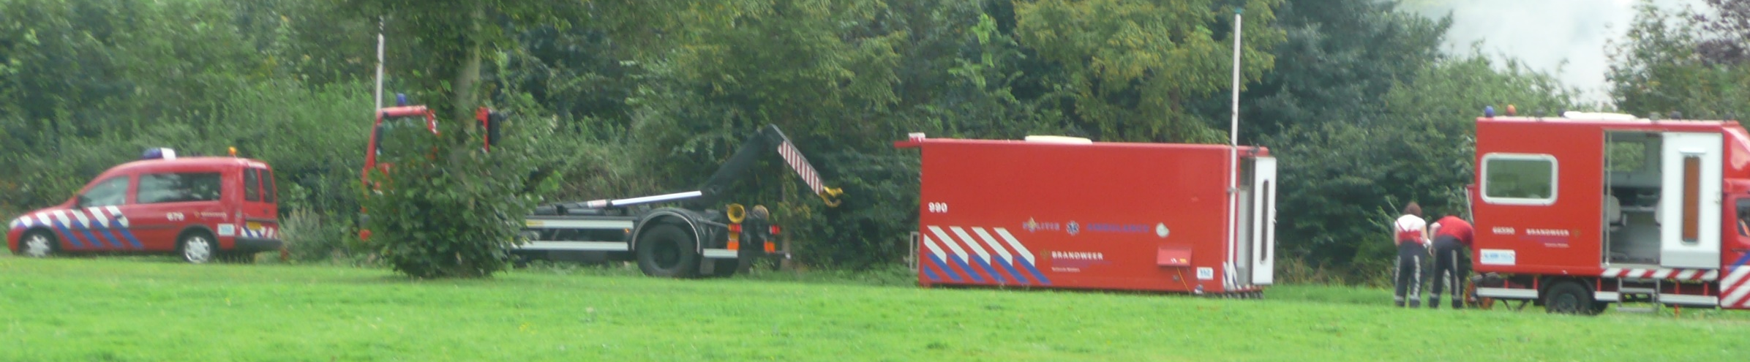
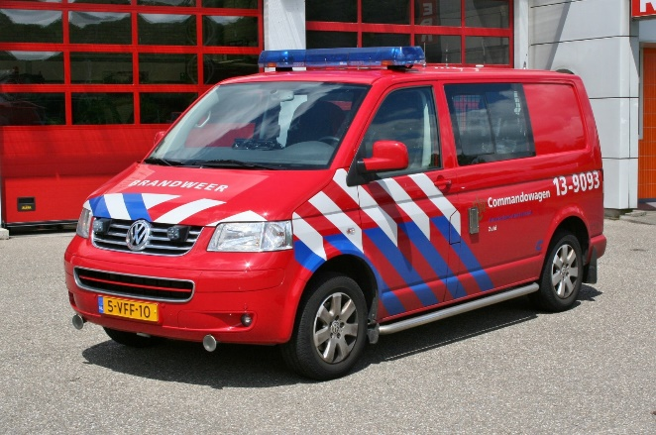
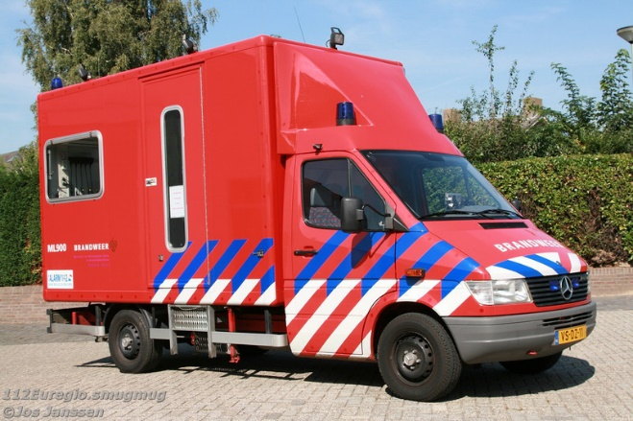
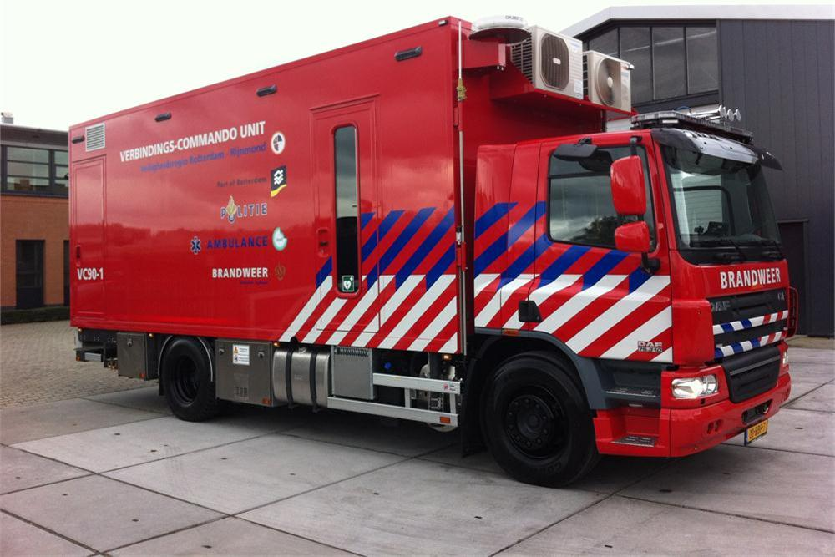
For who is it made?
Fire department
Commander (OvD)
VC-3/2/1 (Connection and commandvehicle)
Notes:
VC-1: Large truck (only in Waalre & Barendrecht) VC-2: Mercedes van VC-3: transporter. Container-thing: VC-2/3 + container = VC-1

Slide 3
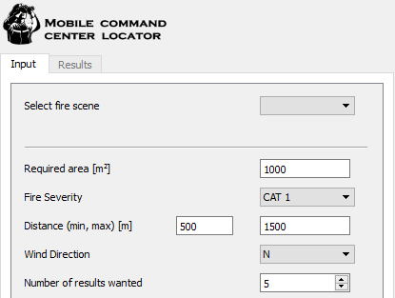
What does it do?
Supports decision on placing MCC by:
Providing suitable areas based on a set of parameters:
Notes:
In case of a fire, where a Mobile Command Center (MCC) is required, this tool supports the decision on where to place the MCC. It does this by providing a set of suitable areas to the commander, so he doesn’t have to think this through in a situation where time is of great importance.

Slide 4
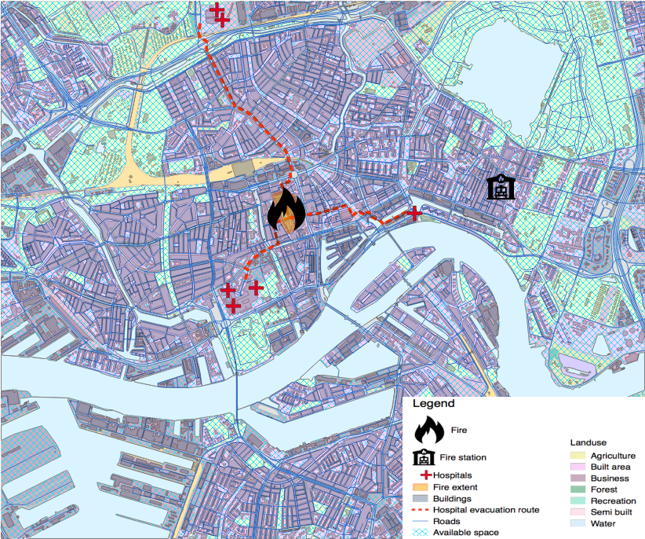
Map/Legend

Slide 5
How does it work? Input
Select Fire Scene
Check parameters
Click on Find Locations!

Slide 6
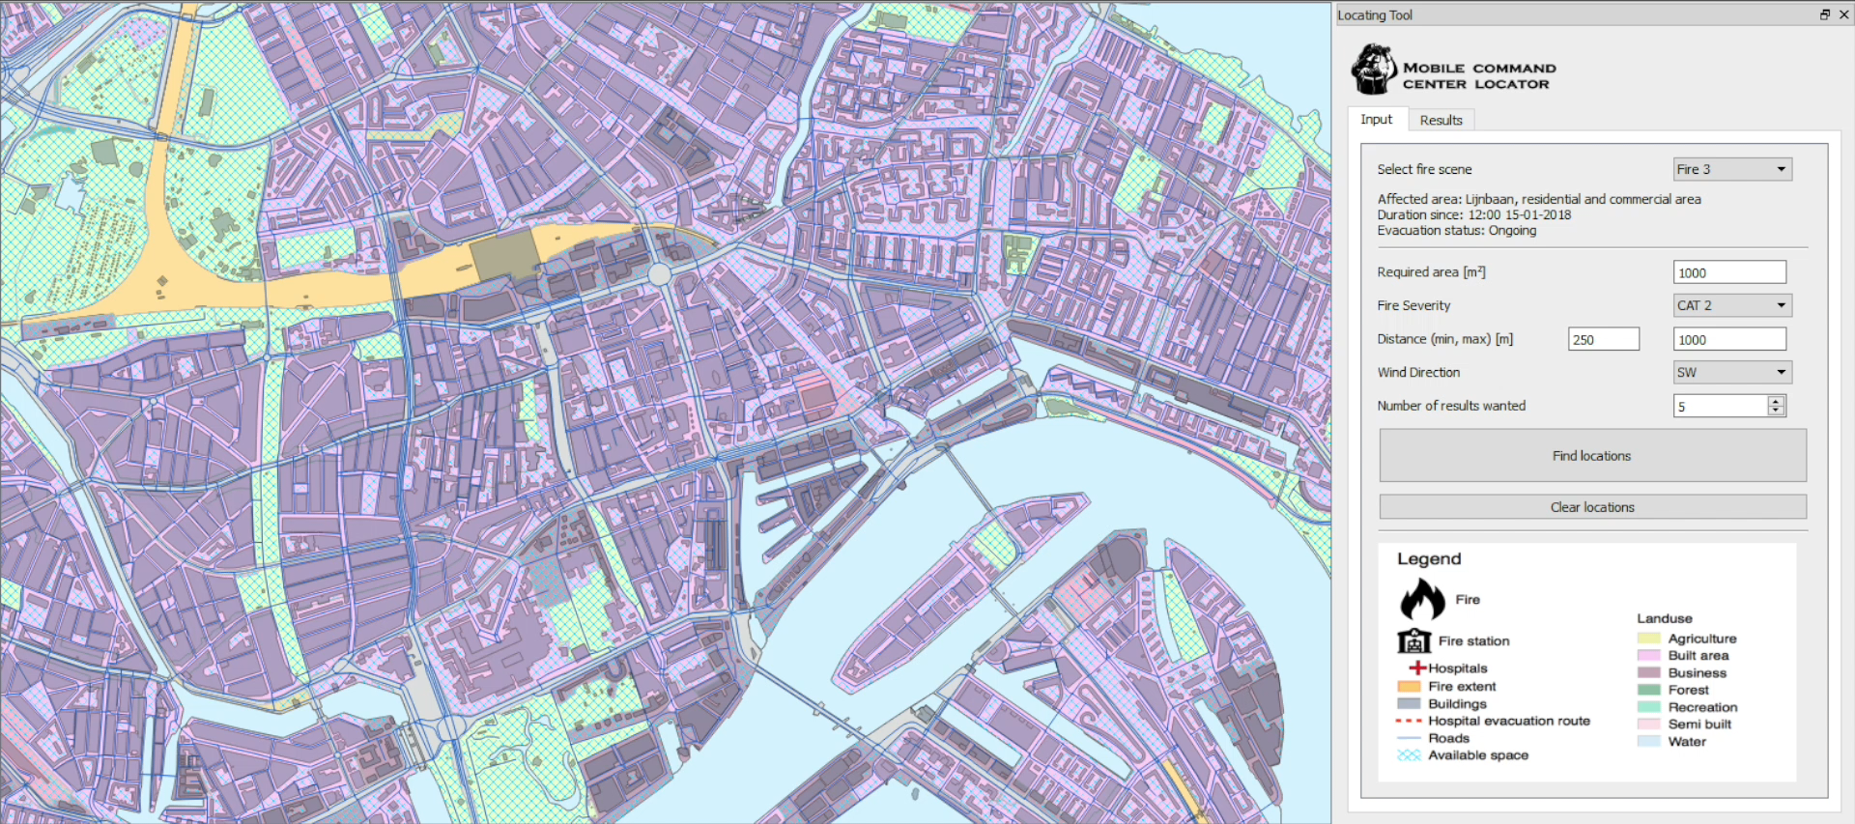
How does it work? Input

Slide 7
How does it work? Results
Zoom to focus area
Zoom to locations
Mark location(s)
Clear location(s)

Slide 8
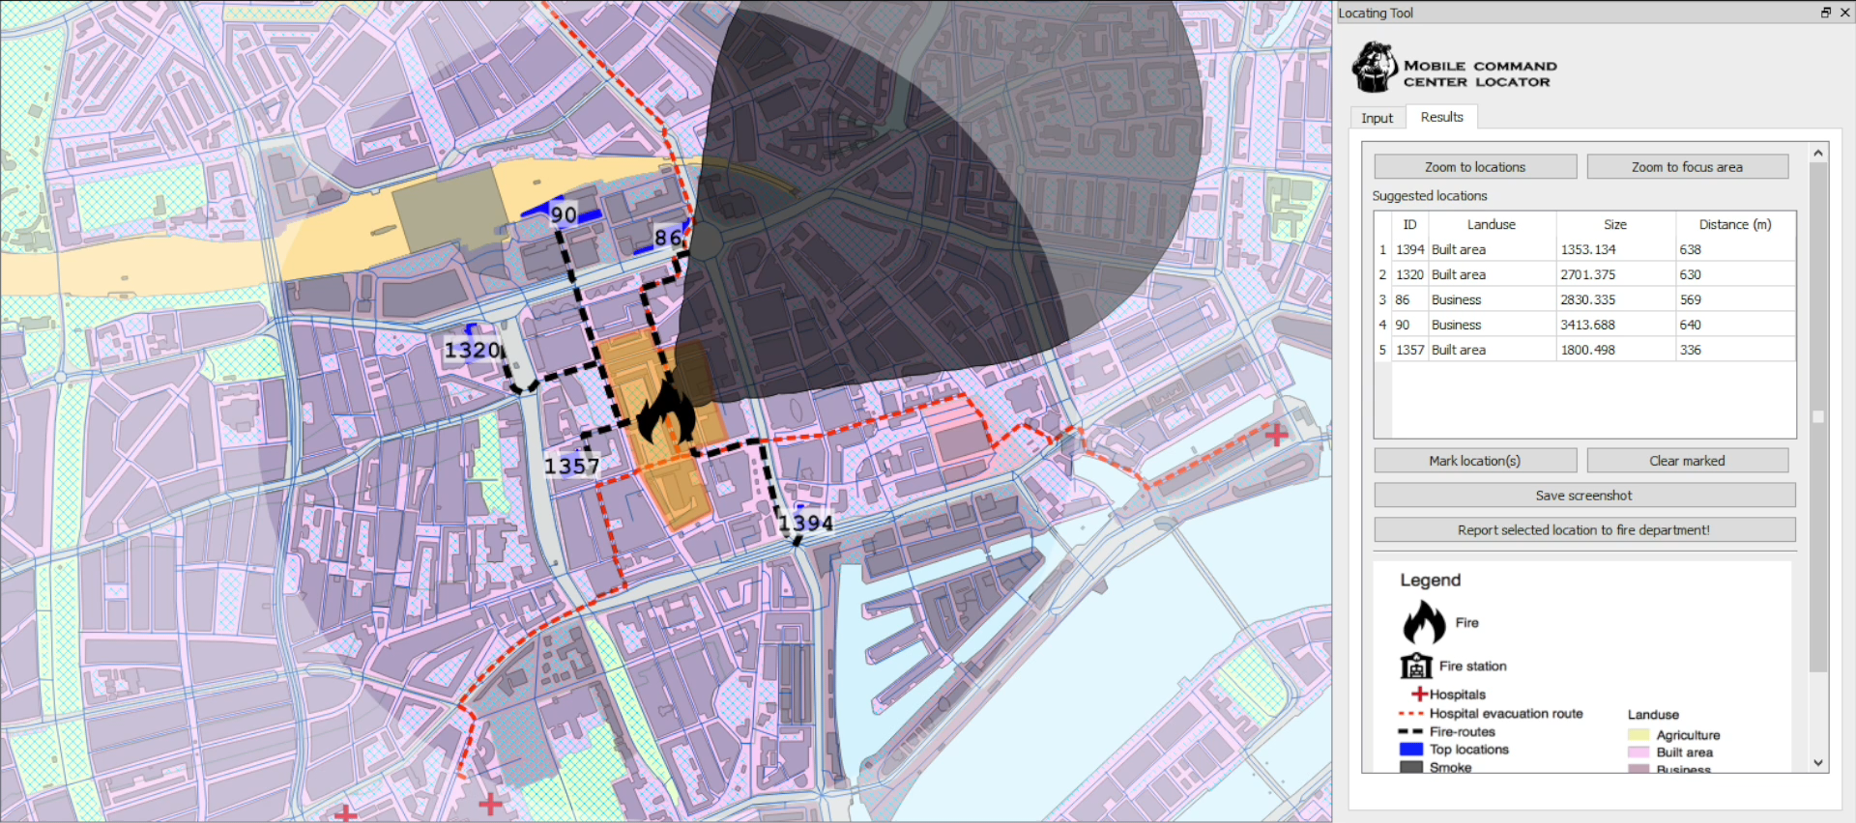
How does it work? Results

Slide 9
How does it work? Reporting
Save screenshot

Slide 10
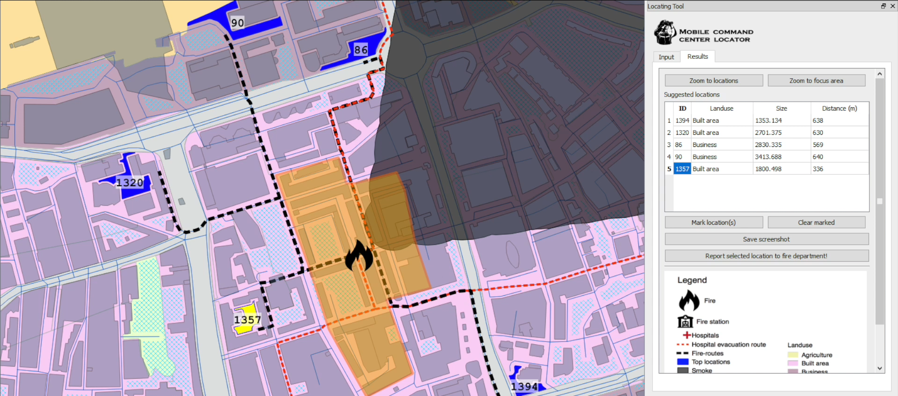
How does it work? Reporting - Screenshot

Slide 11
How does it work? Reporting - Report
Report to fire department

Slide 12
How does it work? Reporting - Report

Slide 13
